Slide 1

Modern day C# development in Visual Studio “15”
Kevin Pilch
Principal Software Engineering Manager
Microsoft

Slide 2
Demos

Slide 3
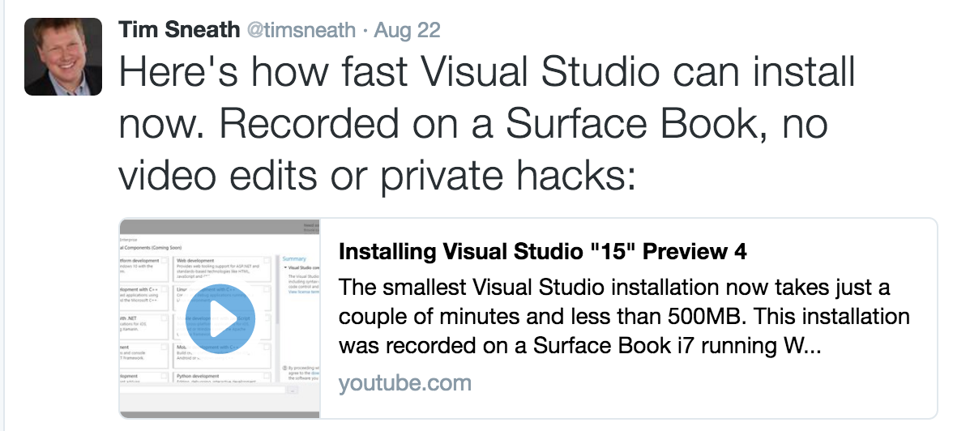
General
New acquisition experience
https://twitter.com/timsneath/status/767796679806332928
Deferred project load
Out of Process: Analyzers + CodeLens

Slide 4
Code Style
Naming styles
Qualify with “this.”
Use ”var” or explicit types
Use language keyword or framework type name
Add braces
(soon) .editorconfig support

Slide 5
Navigation
F12 Go to Definition
Alt+F12 Peek Definition
Ctrl+F12 Go to Implementation (VS2015 U2)
Shift+12 Find all References
Ctrl+T/Ctrl+, Go To (aka Navigate To)

Slide 6
Refactoring
Ctrl+.
Convert to interpolated string
Replace delegate invoke with ?.
Introduce local
Inline temp
Extract method
Change Signature
Extract interface
Rename (F2)

Slide 7
Productivity
Indent guides
Fuzzy matching + spell check
Add reference (metadata or project)
Add NuGet package reference
Completion filtering and bolding
Target typing in completion
Add switch cases

Slide 8
Thanks!
Kevin Pilch
kevinpi@microsoft.com
@Pilchie
http://roslyn.io

